Slide 1
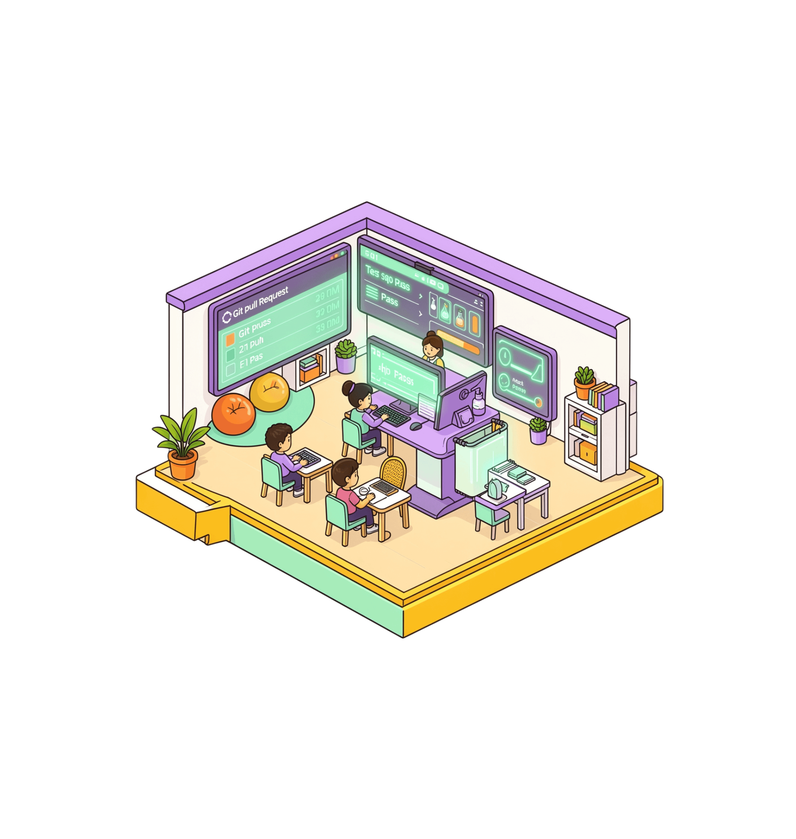
GitHub Hackathon 2026 · [Team name]
From GitHub issue to reviewed pull request
An AI engineering agent for the small fixes that quietly consume maintainer time.
SUBMISSION DATE · 7 OCTOBER 2026
Notes:
Introduce the project: an engineering agent built to automate the high-frequency, low-creativity fixes that backlog maintainers and delay contributor momentum.

Slide 2
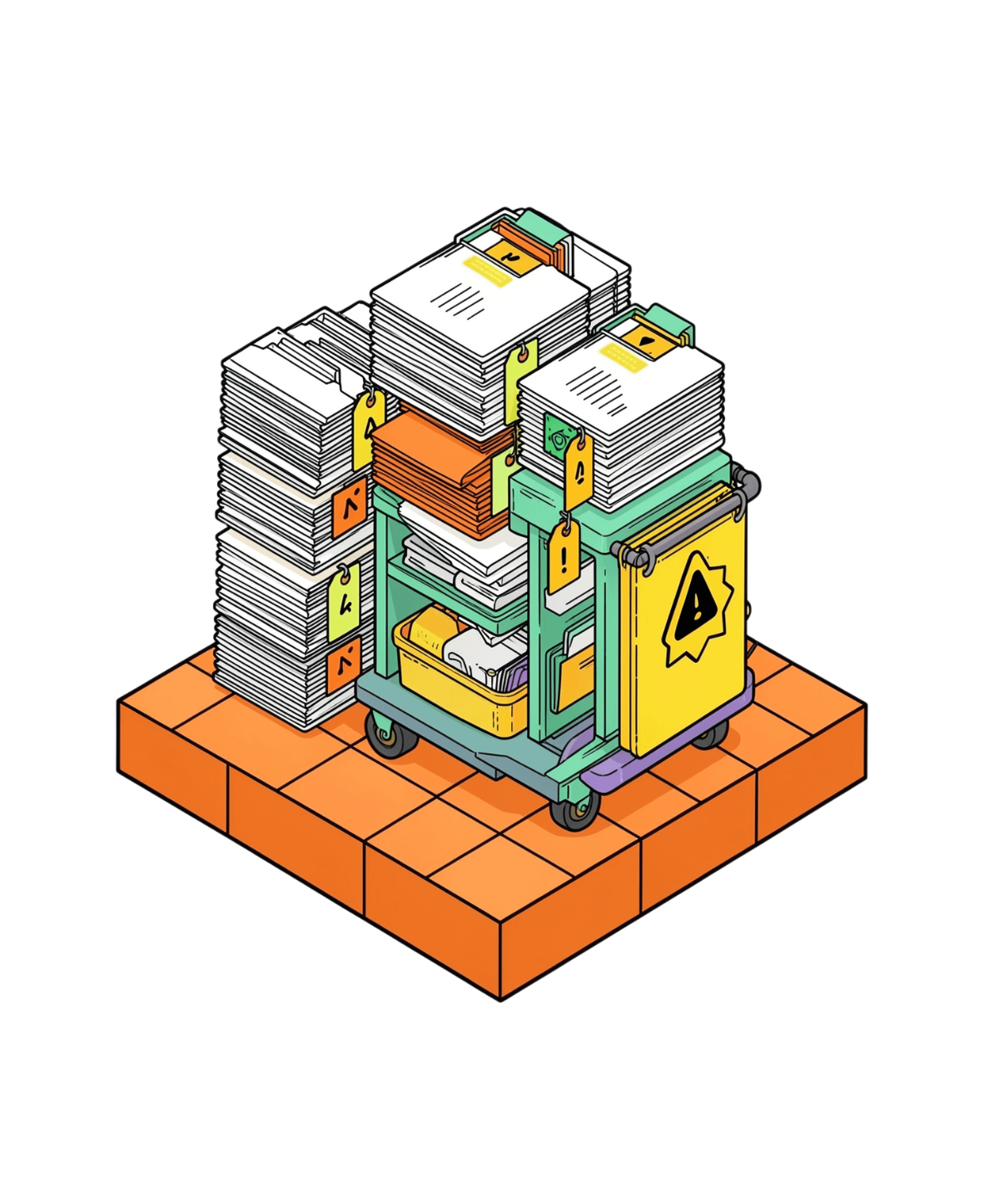
Small issues create a large maintenance tax
Low-creativity backlog work
Typos, minor bugs, and documentation fixes require context switches rather than deep design thinking.
Maintainer queue congestion
Even a five-minute fix sits in queues for days, draining attention away from core roadmap features.
Contributor stall
External contributors and team members wait longer for feedback, validation, and an obvious path to contribution.
Notes:
Every maintainer recognizes this friction: minor documentation errors and tiny typos create disproportionate queue overhead and leave contributors waiting.

Slide 3





CORE ARCHITECTURE
Give every small issue a safe path to done
The Issue-to-PR Agent automates the mechanical pipeline from problem report to mergeable review.
1. Read Issue
2. Locate File
3. Write Fix
4. Run Tests
5. Open PR
Ingests issue title, context, and issue description.
Identifies the exact file and line needing changes.
Generates a concise, minimal patch that solves the issue.
Executes test suites to ensure zero regressions.
Delivers a clear explanation ready for human review.
Notes:
Explain the end-to-end mission: eliminating the manual gap between issue creation and pull request submission with a deterministic, disciplined agent lifecycle.

Slide 4
Five steps from issue to review
A disciplined, reproducible lifecycle executed on every triggered issue
1
2
3
4
5
Target
Patch
Verify
Deliver
Safeguard
Read the issue and identify the likely file in the repo.
Generate the smallest useful change that solves the problem.
Run all available tests locally before publishing code.
Open a pull request with the full reasoning and test output.
Pause for human clarification whenever confidence is low.
Notes:
Highlight the five distinct stages. Emphasize step 5: pausing when uncertain is what makes this agent safe for production repositories.

Slide 5


Automation stops before trust breaks
Explicit safety bounds keep the agent useful without risking repository integrity
Protected Main Branch
Confidence Check
Human In The Loop
The agent never pushes directly to main or production branches. Every modification arrives isolated on a dedicated feature branch.
Instead of guessing through ambiguity, the agent checks its own confidence. If file targeting or test coverage is uncertain, it halts and requests input.
Leaves the final merge decision entirely to human reviewers. Maintainers retain absolute authority over what enters the codebase.
Notes:
Safety is the primary feature of this agent. It is designed to act as an eager junior engineer who always submits PRs for review rather than committing to production.

Slide 6
Simple stack, focused job
Three proven components working in seamless concert
RUNTIME
PLATFORM
INTELLIGENCE
Python
GitHub API
Claude
Orchestrates the agent workflow, executes local commands, monitors test runners, and coordinates tool execution with deterministic error handling.
Reads incoming issues, pulls repository file trees, checks existing CI runs, and opens structured pull requests directly in the repository.
Analyzes issue descriptions, localizes the bug, drafts targeted code modifications, and articulates a concise technical explanation for reviewers.
Notes:
Walk through the architecture: Python handles orchestrating the pipeline, GitHub API provides seamless ecosystem access, and Claude delivers accurate, surgical code fixes.

Slide 7


Demo: “Helo” becomes a reviewable fix
One tiny issue, one traceable change, one human review
AGENT EXECUTION & PR #2
GITHUB ISSUE #1
1
Locate: Agent scans repository and finds README.md.
Issue: “Helo typo in README”
Reported by contributor: README.md line 1 reads 'Helo world'
2
Patch: Replaces Helo with Hello cleanly.
3
Deliver: Opens Pull Request with title Closes #1.
PR #2 opened: “Fixes typo in README documentation. Closes #1.” · Tests passed.
Status: Open · Waiting on maintainer triage
Notes:
Point to the demo: an issue that would typically sit idle for three days is parsed, targeted, tested, and turned into a ready-to-merge PR within seconds.

Slide 8
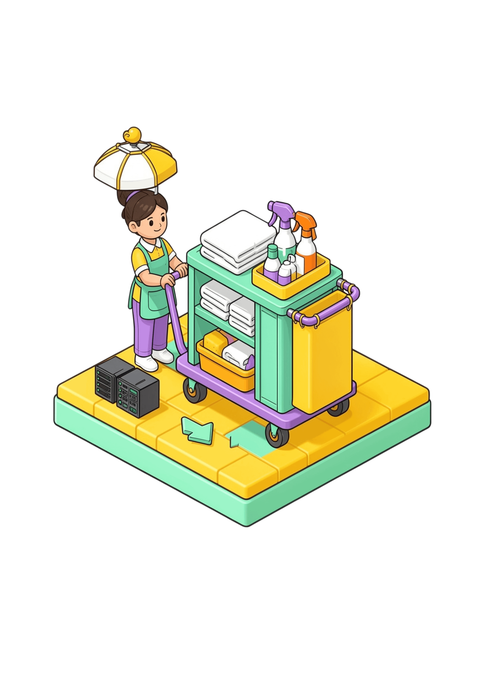
Start with small fixes. Scale with confidence.
Ship the safe first version now; expand the trust boundary deliberately.
Immediate Impact
Faster issue resolution, reduced maintainer maintenance burden, and a quicker, more encouraging onboarding path for new contributors.
Roadmap & Next Steps
Introduce autonomous reviewer agents, isolated sandbox test execution, and real-time GitHub webhook automation.
Submitted 7 October 2026 · Built for the GitHub Hackathon
Notes:
Close by reiterating the pragmatic strategy: begin with bounded, risk-free tasks, prove trust and value, and expand capabilities deliberately.

